Slide 1

Gamma Demo Scorecard for Cash Loan
Presented by:
Data Science
March 2025

Slide 2
Architecture Overview of TDB’s Risk Scorecards
For Cash Loan only
For both Cash and SIL
Limit Setting Model (Hosted in Digital Layer)
Credit Decisioning Model (Hosted in Taran)
Beta Stack
Alpha Stack
Trench 1: New Users - within 30 days from TSA Onboarding AND Never Disbursed Loan
Limit Setting Score = Gamma Stack
Beta Demo Score
Beta Demo Score
Gamma Demo Score
Apps Score
Apps Score
Selectively call Alpha
Apps Score
Credo Score
Users automatically move from Trench 1 to Trench 2 after 30 days if no disbursed loans
Credo Score
CIC Score
Gamma Income Model
Beta Income Model
Alpha Income Model
Users will stay in Trench 2 until 1st disbursed loan. His Gamma Stack will be re-calculated every 30-day anniversary from TSA onboarding date
Limit Setting Score = Gamma Stack
Beta Stack
Alpha Stack
Gamma Demo Score
Beta Demo Score
Beta Demo Score
Trench 2: Existing Users - After 30 days from TSA Onboarding AND Never Disbursed Loan
Apps Score
Apps Score
Selectively call Alpha
Apps Score
Transaction Score
Transaction Score
Transaction Score
CIC Score
Gamma Income Model
Beta Income Model
Alpha Income Model
Users will move to Trench 3 after 1st Disbursed Loan
Lowest Risk users from this B Score will be pre-approved for upsell and xsell. Medium Risk users from this B Score will have to go through Taran.
High Risk users from this B Score will not be given any offer.
B Score = Gamma Stack
Trench 3: Existing Users - After 30 days from 1st Disbursed Loan AND current DPD <= 10
Gamma Demo Score
Beta Stack
Alpha Stack
Apps Score
Beta Demo Score
Beta Demo Score
Apps Score
Apps Score
Enhanced Transaction Score
Selectively call Alpha
Enhanced Transaction Score
Once moved to Trench 3, user will forever remain in Trench 3. His Gamma Stack will be re-calculated every 30 days anniversary from 1st Loan Disbursement Date
Enhanced Transaction Score
CIC Score
Gamma Income Model
Beta Income Model
Alpha Income Model

Slide 3
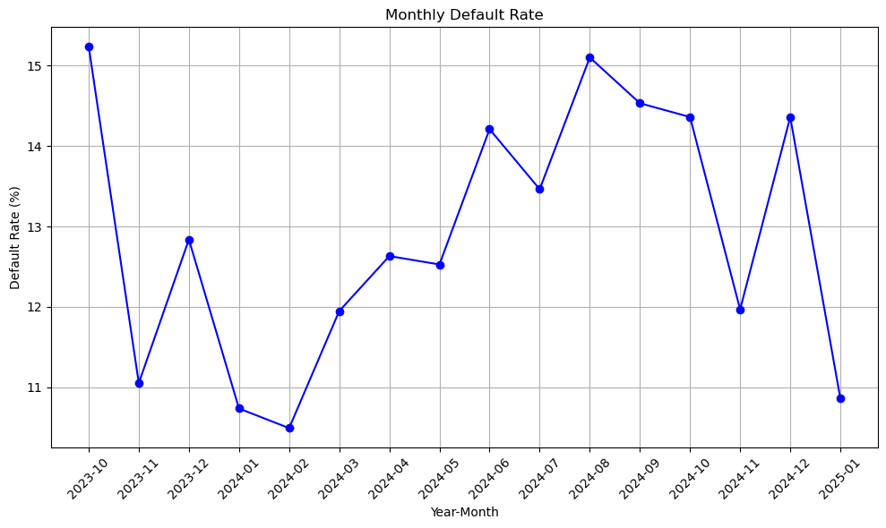
Cash Gamma Demo Score was developed on Trench 1 (DOB <= 30 and without any disbursed loan) and Trench 2 (DOB > 30 and without any disbursed loan)
 | Loan Disbursement Date | # CASH Loans |  |  | # Bad (FPD30) CASH Loans |  |  | FPD30 rate
 |  | Overall | Trench1 | Trench2 | Overall | Trench1 | Trench2 | Overall | Trench1 | Trench2
All Data Training – 90%,val – 10% | 06/10/2023 - 31/10/2024 | 15937 | 10189 | 5748 | 2226 | 1439 | 787 | 0.1396 | 0.1412 | 0.1369
Nov | 01/11/2024 - 30/11/2024 | 3292 | 1998 | 1294 | 394 | 223 | 171 | 0.1196 | 0.1116 | 0.1321
Dec | 01/12/2024 - 31/12/2024 | 2319 | 1551 | 768 | 333 | 213 | 120 | 0.1435 | 0.1373 | 0.1562
Jan | 01/01/2025 - 11/01/2025 | 488 | 329 | 159 | 53 | 35 | 18 | 0.1086 | 0.1063 | 0.1132

Slide 4
Model Iteration ​ | Top Features​ | Train Gini​ (2023-10-06- 2024-10-31)​ | Val Gini​ | Nov Gini​ | Dec Gini​ | Jan Gini​ (01-01-2025 - 11-01-2025)​
8 | ln_self_dec_income, ln_industry_new_cat_bin, ln_age, ln_employment_type_new_cat, ln_education_level, days_on_book, ln_marital_status, ln_nature_of_work_new_cat, | 0.3079 | 0.2375 | 0.2179 | 0.1664 | 0.2062
9 | ln_doc_type_rolled | 0.3308 | 0.2484 | 0.2246 | 0.1714 | 0.1869
10 | email_primary_domain | 0.3454 | 0.248 | 0.2341 | 0.1665 | 0.1834
11 | ln_osversion_type_order | 0.3347 | 0.2499 | 0.2353 | 0.159 | 0.1605
12 | days_since_os_version_release | 0.355 | 0.2459 | 0.2365 | 0.1689 | 0.1725
13 | Onboarding_time_of_day_cat | 0.3339 | 0.2474 | 0.2329 | 0.1559 | 0.1557
14 | ln_city_cat | 0.339 | 0.2428 | 0.2313 | 0.1626 | 0.1686
15 | ln_brand_cat | 0.3512 | 0.2473 | 0.2349 | 0.1636 | 0.1811
16 | ln_province_cat | 0.3423 | 0.2422 | 0.2332 | 0.1616 | 0.1735
17 | ln_cnt_dependents | 0.3508 | 0.2459 | 0.232 | 0.1617 | 0.1702
18 | name_email_match_score | 0.3735 | 0.2423 | 0.2304 | 0.173 | 0.1717
12 feature model after Hyper Parameters Tuning​ | ​ | 0.2719 | 0.2412​ | 0.2313​ | 0.1615​ | 0.2008

Slide 5
Cash Gamma Demo Model Performance
Gamma Demo Model Gini | 06/10/2023 - 31/10/2024​​ |  | 01/11/2024 - 30/11/2024​ | 01/12/2024 - 31/12/2024​​ | 01/01/2025 -11/01/2025​​
​ | Train Gini (90%)​​ | Val Gini (10%)​​ | Nov Gini​​ | Dec Gini​​ | Jan Gini
Overall Demo Model Gini | 0.2719 | 0.2412 | 0.2313 | 0.1615 | 0.2008
Demo Trench 1 Gini |  |  | 0.1964 | 0.1413 | 0.2218
Demo Tench 2 Gini |  |  | 0.2742 | 0.1921 | 0.1631

Slide 6
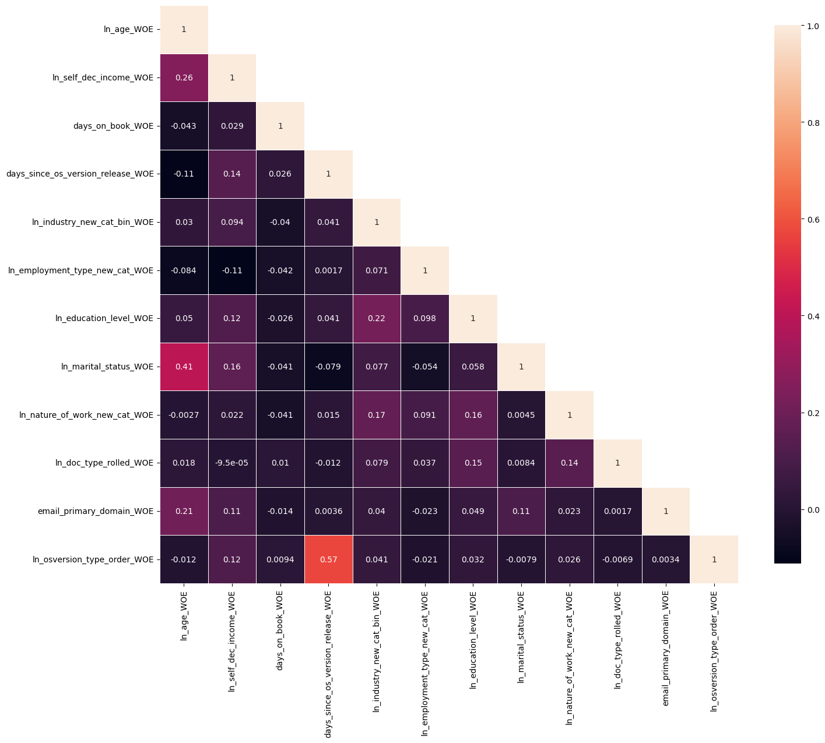
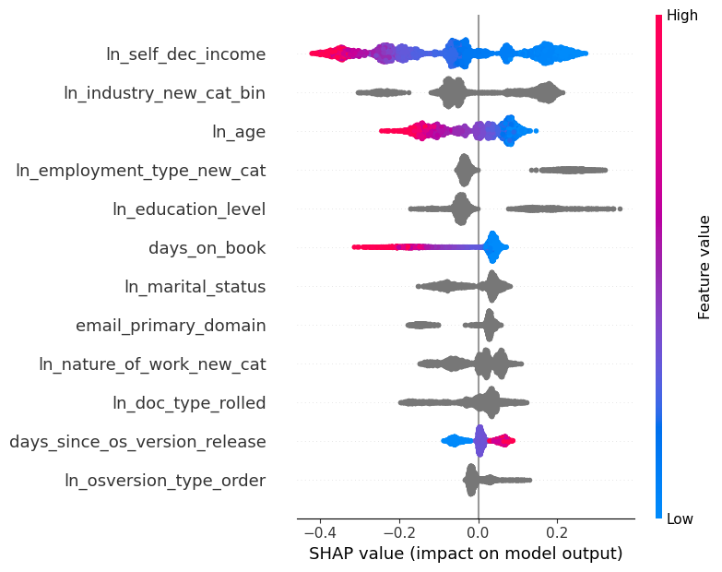
Gamma Quick Demo – Model Performance

Slide 7
Gamma Demo Quick

Slide 8
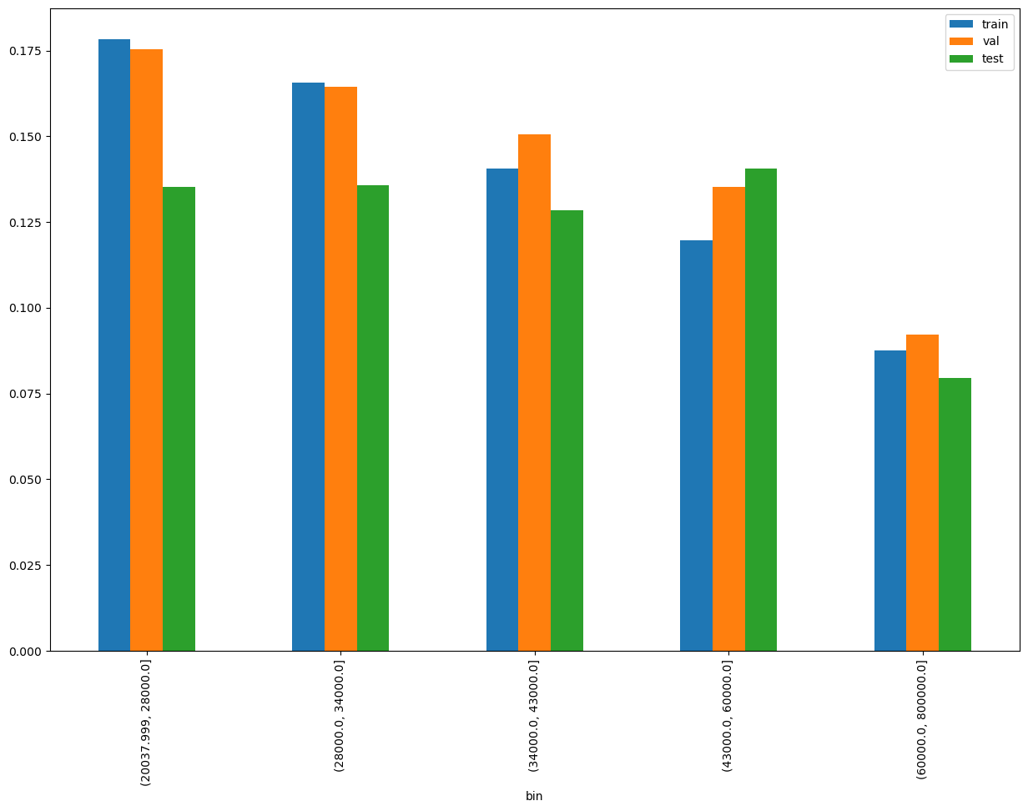
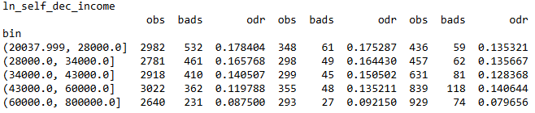
SHAP Rank: 1
ln_self_dec_income

Slide 9
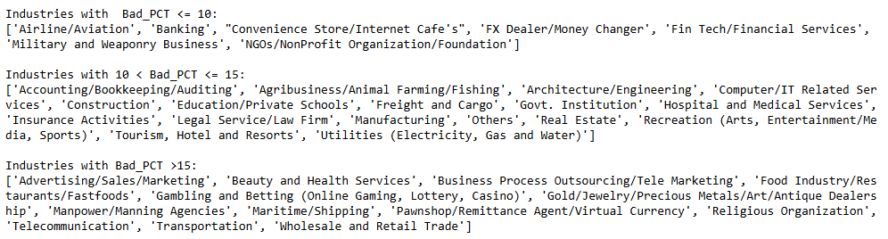
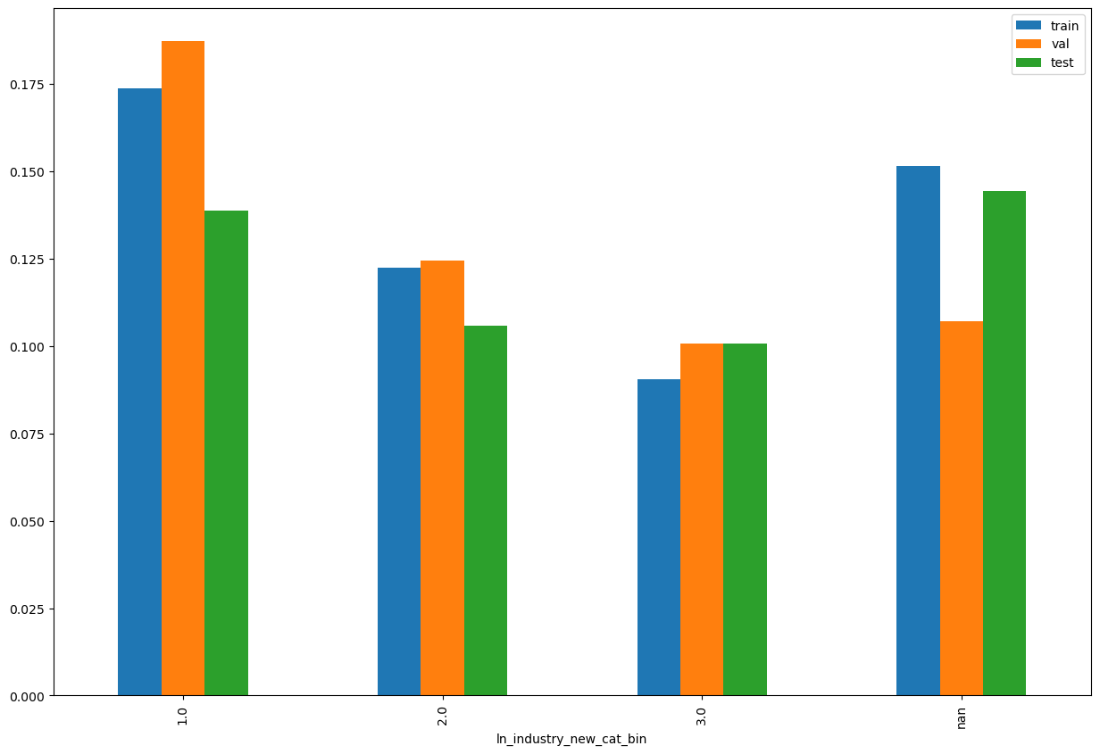
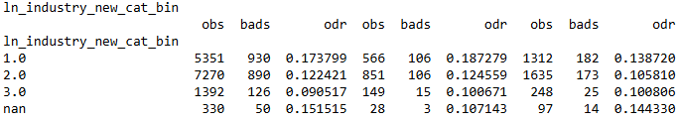
SHAP Rank: 2
ln_industry_new_cat_bin

Slide 10
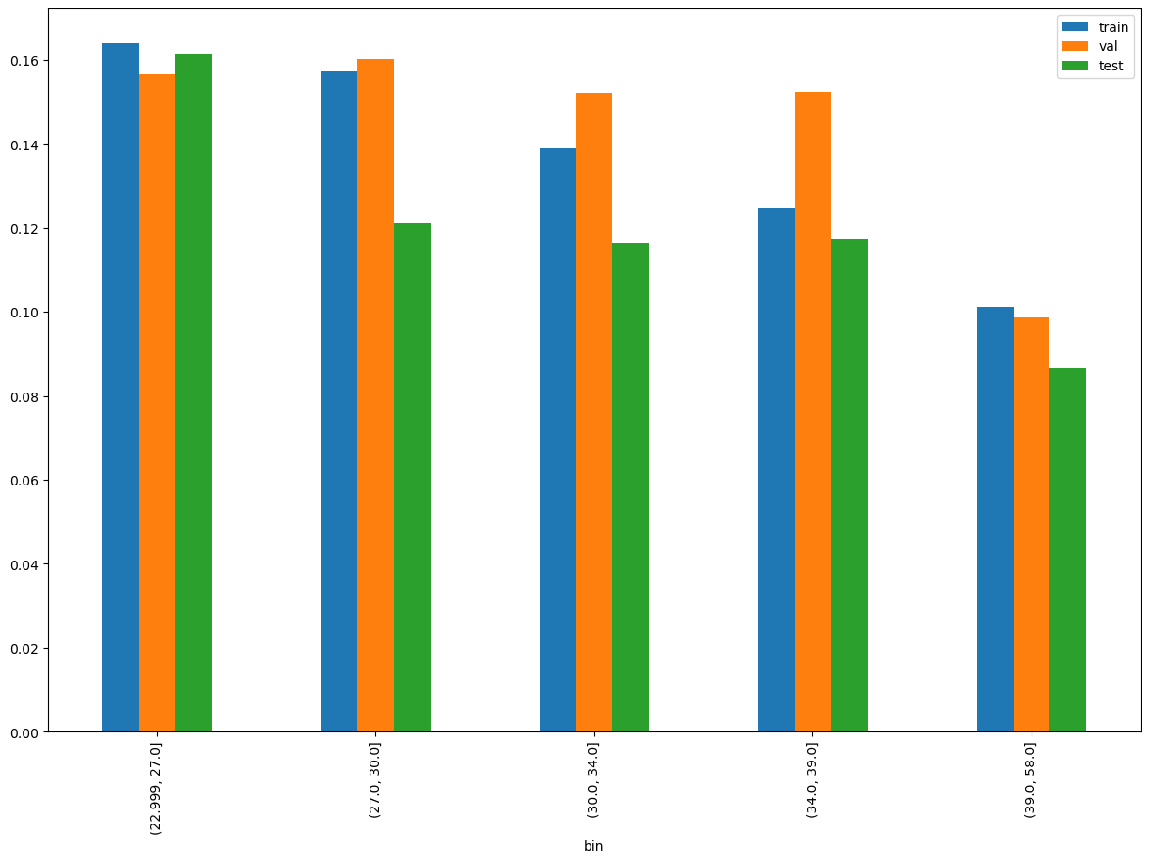
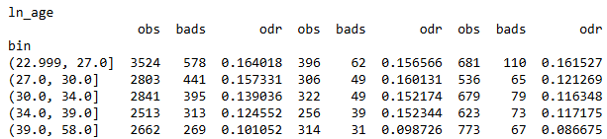
SHAP Rank: 3
ln_age

Slide 11
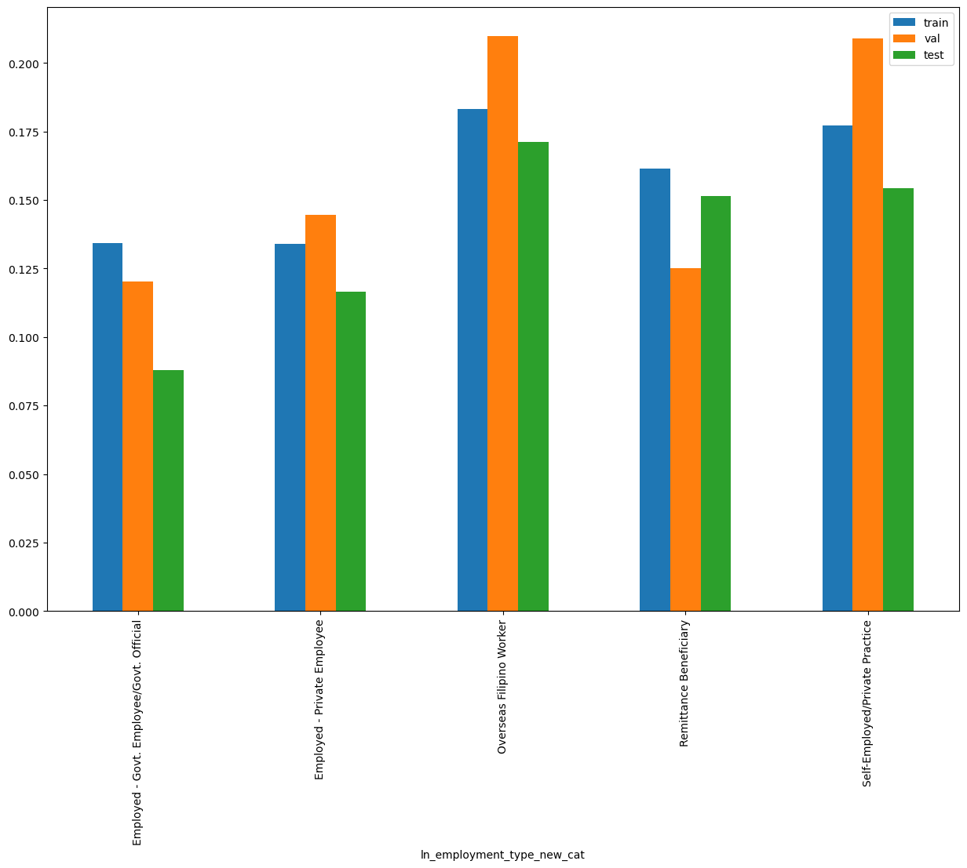
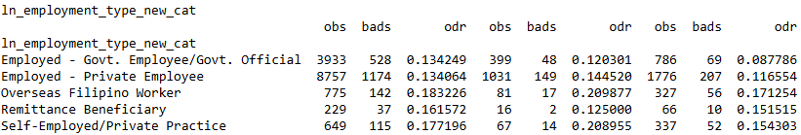
SHAP Rank: 4
ln_employment_type_new_cat

Slide 12
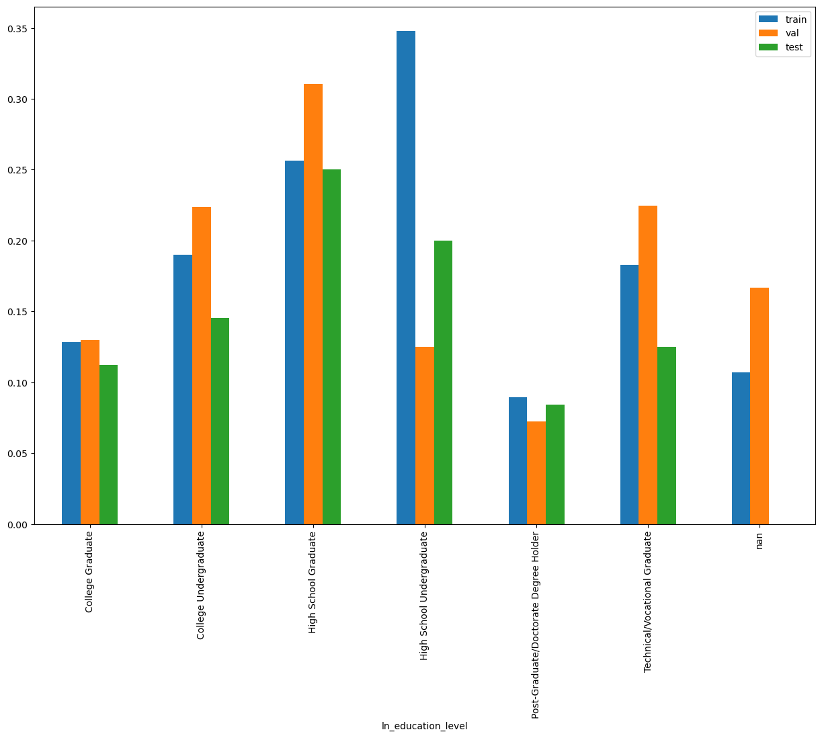
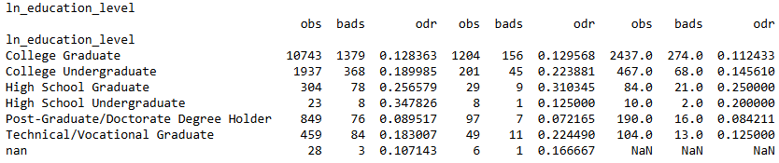
SHAP Rank: 5
ln_education_level

Slide 13
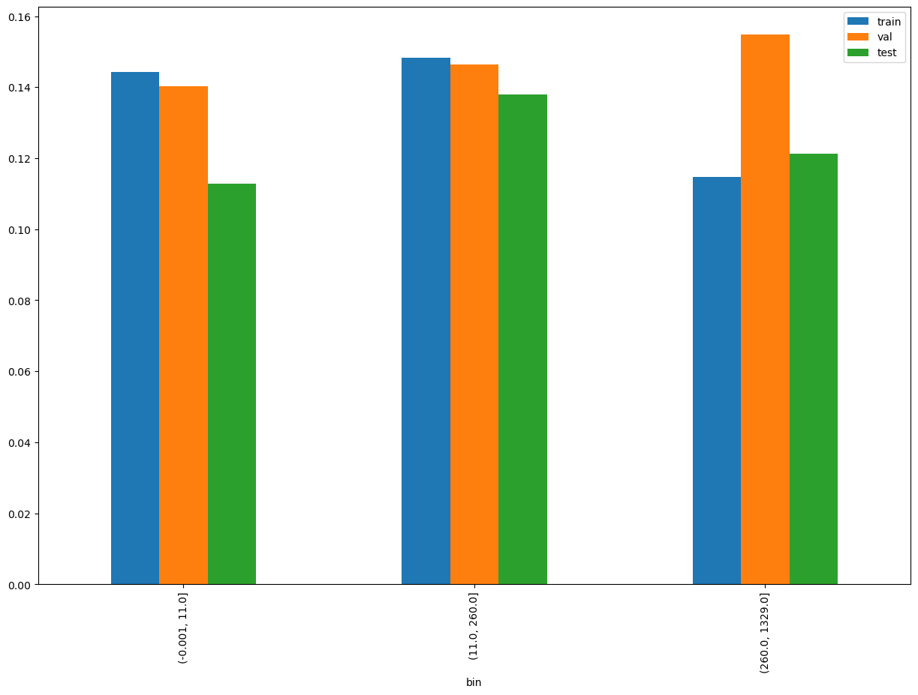
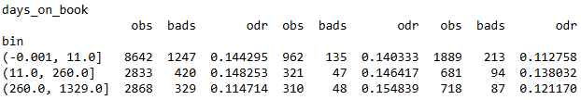
SHAP Rank: 6
days_on_book

Slide 14
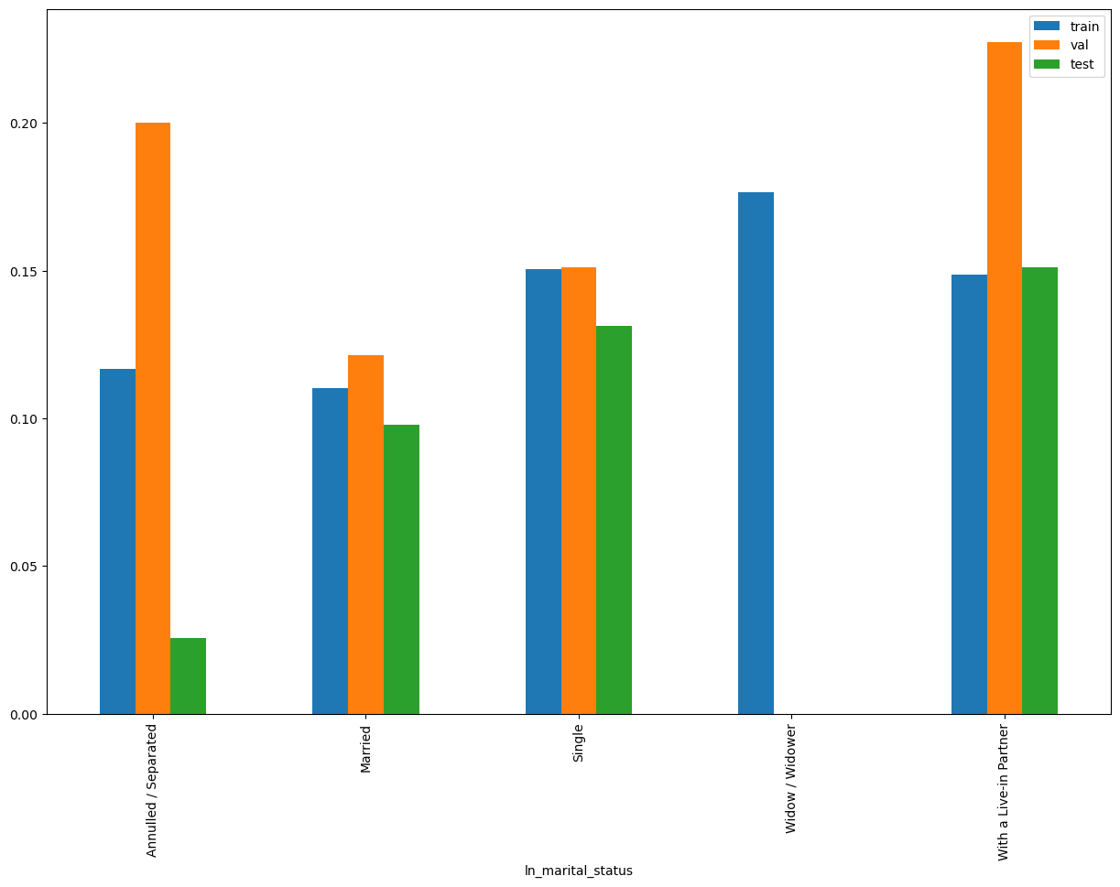
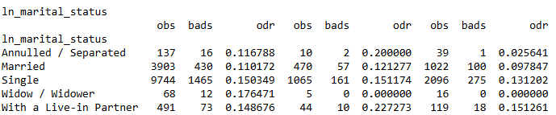
SHAP Rank: 7
ln_marital_status

Slide 15
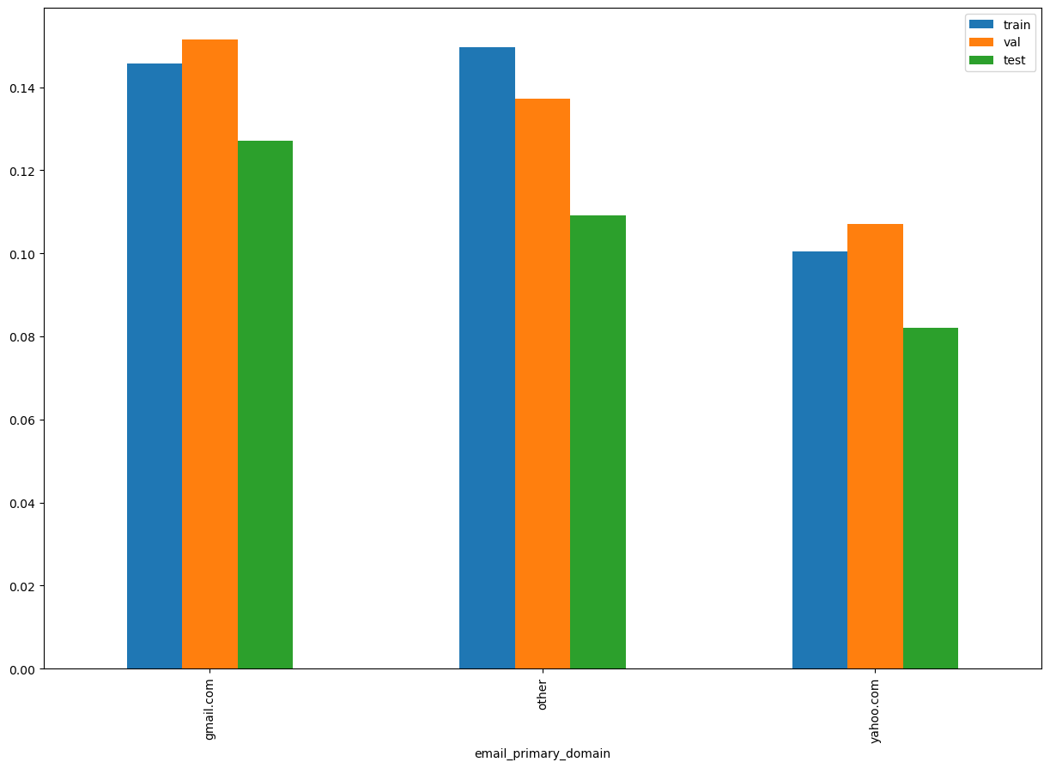
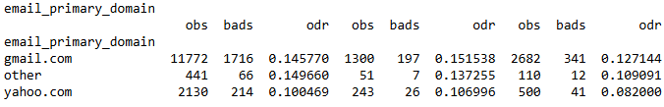
SHAP Rank: 8
email_primary_domain

Slide 16
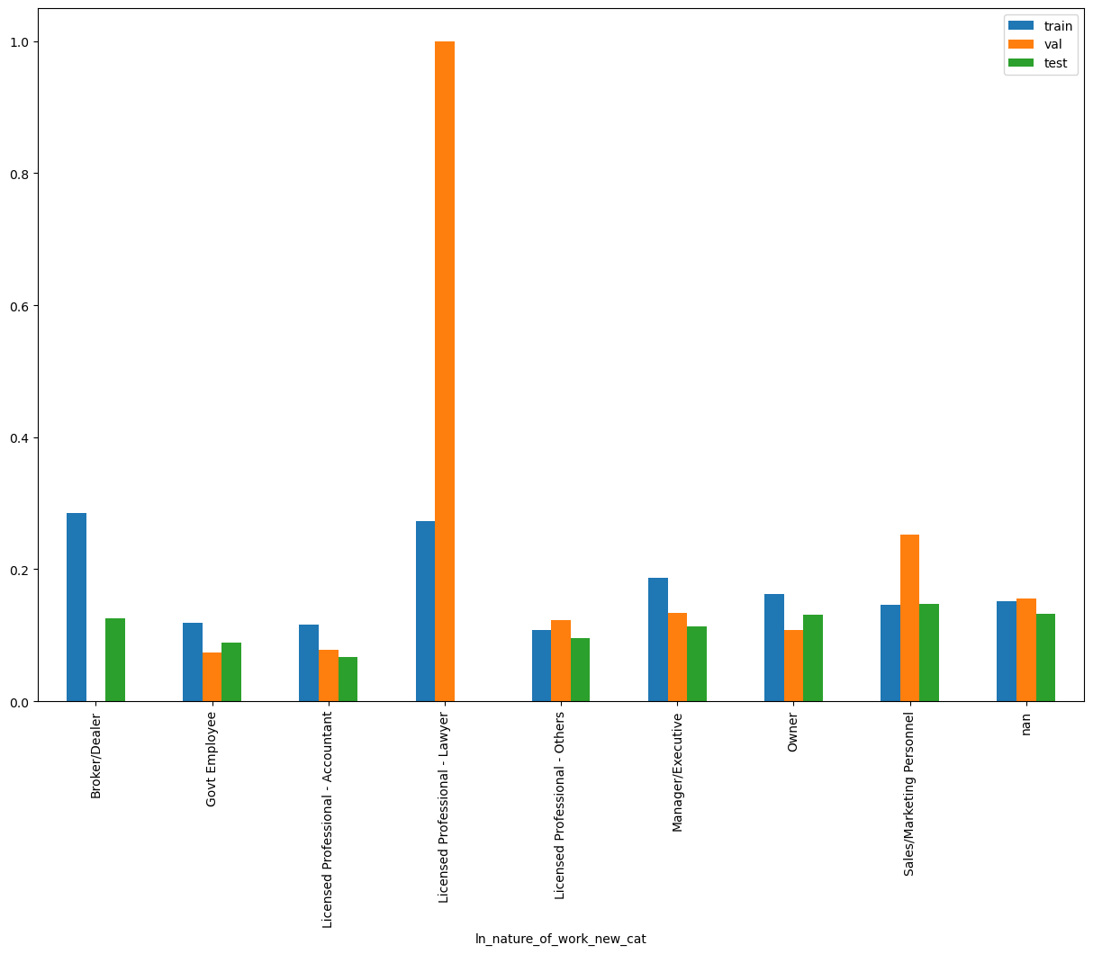
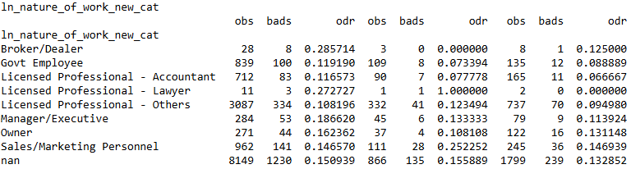
SHAP Rank: 9
ln_nature_of_work_new_cat

Slide 17
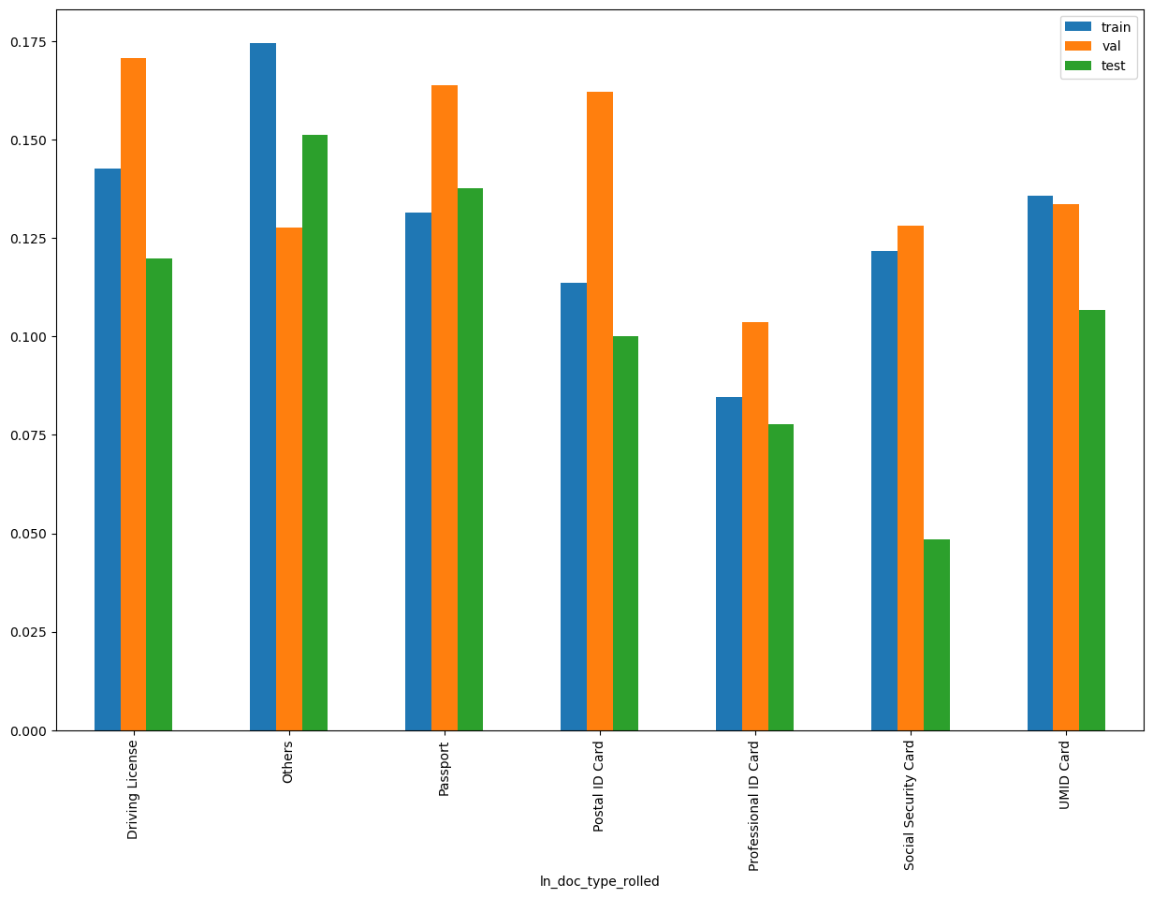
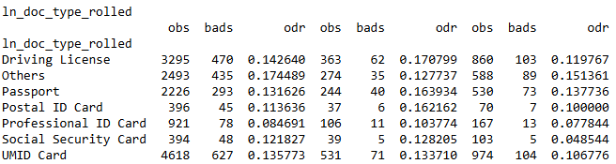
SHAP Rank: 10
ln_doc_type_rolled

Slide 18
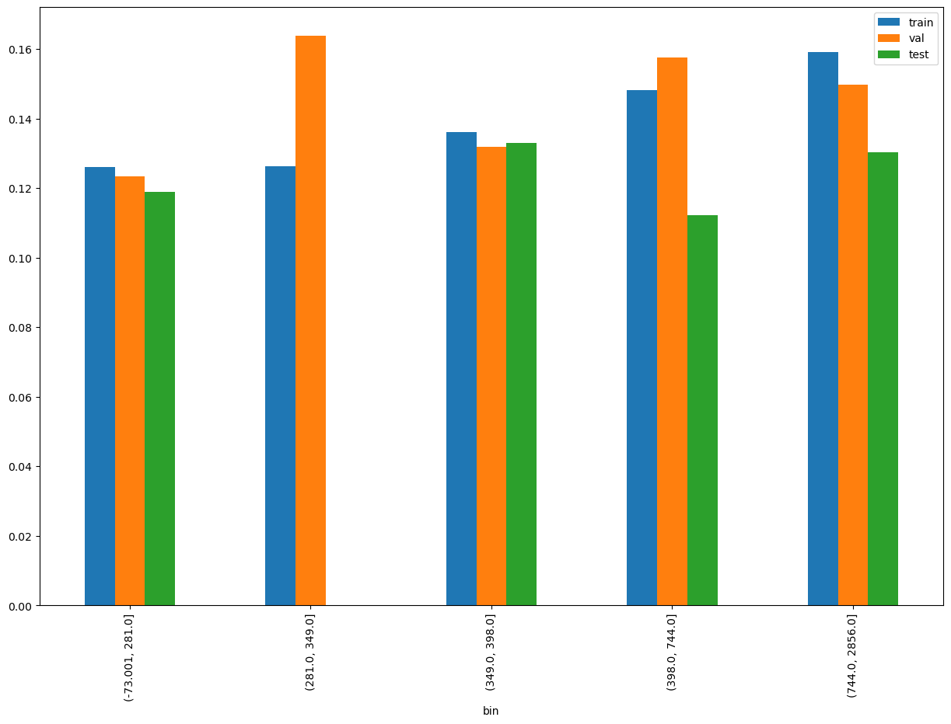
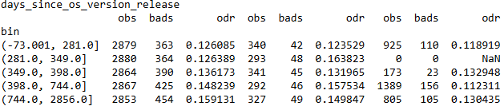
SHAP Rank: 11
days_since_os_version_release

Slide 19
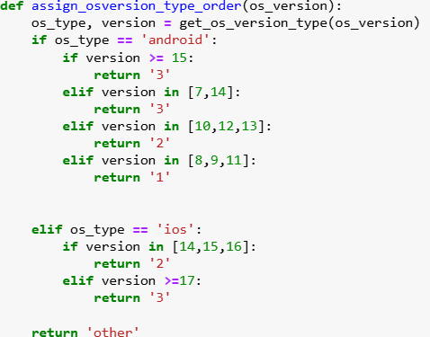
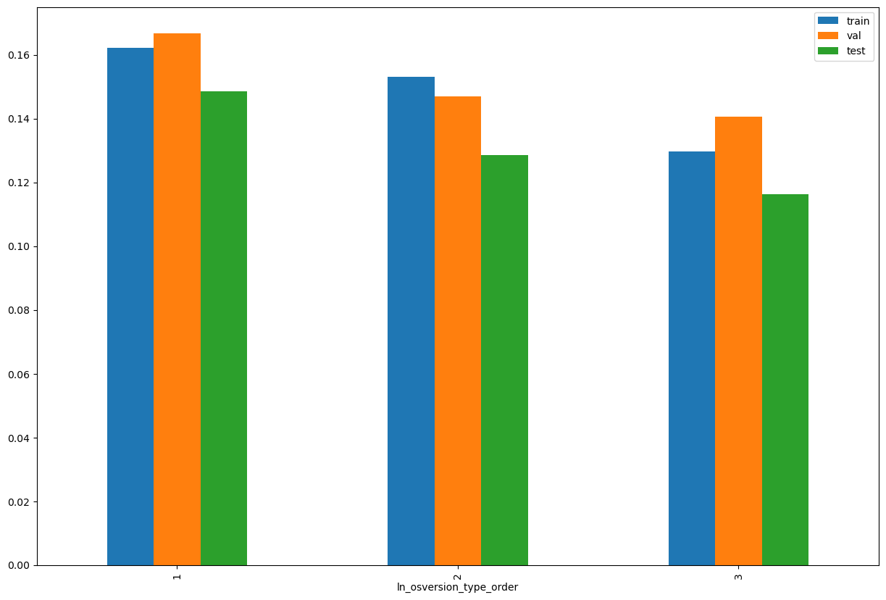
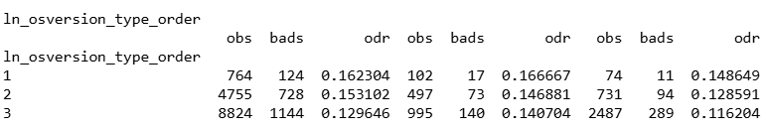
SHAP Rank: 12
ln_osversion_type_order

Slide 20
Gamma Trench 1 Stack Model

Slide 21
Trench 1 Gamma Stack for Cash Loan
Gamma Trench 1 stacking - Android​​ | 06/10/2023 - 31/10/2024​​ |  | 01/11/2024 - 30/11/2024​ | 01/12/2024 - 31/12/2024​​ | 01/01/2025 -11/01/2025​​
​​ | Train Gini (90%)​​ | Val Gini (10%)​​ | Nov Gini​​ | Dec Gini​​ | Jan Gini
Demo | 0.2719 | 0.2412 | 0.2313 | 0.1615 | 0.2008
Demo + Credo | 0.4817 | 0.3987 | 0.2882 | 0.1972 | 0.3886
Demo + Apps | 0.5224 | 0.4858 | 0.2750 | 0.1446 | 0.4300
Demo + Apps + Credo | 0.5458 | 0.4687 | 0.3036 | 0.1847 | 0.4543
For iOS Gamma Stack Credo is making it worse, so better not to use it
Gamma Trench 1 stacking - IOS | 06/10/2023 - 31/10/2024​​ |  | 01/11/2024 - 30/11/2024​ | 01/12/2024 - 31/12/2024​​ | 01/01/2025 -11/01/2025​​
​​ | Train Gini (90%)​​ | Val Gini (10%)​​ | Nov Gini​​ | Dec Gini​​ | Jan Gini
Demo | 0.2719 | 0.2412 | 0.2313 | 0.1615 | 0.2008
Demo + Credo | 0.3510 | 0.3501 | 0.1937 | 0.1281 | 0.1676

Slide 22
Gamma Trench 2 Stack Model

Slide 23
Trench 2 Gamma Stack for Cash Loan
Gamma Trench 2 stacking - Android​​ | 06/10/2023 - 31/10/2024​​ |  | 01/11/2024 - 30/11/2024​ | 01/12/2024 - 31/12/2024​​ | 01/01/2025 -11/01/2025​​
​​ | Train Gini (90%)​​ | Val Gini (10%)​​ | Nov Gini​​ | Dec Gini​​ | Jan Gini
Demo | 0.2719 | 0.2412 | 0.2313 | 0.1615 | 0.2008
Demo + Credo | 0.4923 | 0.4517 | 0.3180 | 0.2196 | 0.4405
Demo + Apps | 0.4952 | 0.5344 | 0.3437 | 0.3759 | 0.4167
Demo + Transaction score | 0.6459 | 0.6763 | 0.3790 | 0.3673 | 0.4048
Demo + Credo + Transaction score | 0.7294 | 0.7332 | 0.4303 | 0.3833 | 0.4127
Demo + Credo + Transaction score + Apps | 0.7745 | 0.7278 | 0.4507 | 0.4132 | 0.4365
Demo + Apps + Credo | 0.5461 | 0.5168 | 0.3601 | 0.3097 | 0.4405
For iOS Gamma Stack Credo is making it worse, so better not to use it
Gamma Trench 2 stacking - IOS | 06/10/2023 - 31/10/2024​​ |  | 01/11/2024 - 30/11/2024​ | 01/12/2024 - 31/12/2024​​ | 01/01/2025 -11/01/2025​​
​​ | Train Gini (90%)​​ | Val Gini (10%)​​ | Nov Gini​​ | Dec Gini​​ | Jan Gini
Demo | 0.2719 | 0.2412 | 0.2313 | 0.1615 | 0.2008
Demo + Credo | 0.4135 | 0.2714 | 0.2876 | 0.1995 | 0.1897
Demo + Transaction score | 0.6400 | 0.6023 | 0.4602 | 0.3020 | 0.4846
Demo + Credo + Transaction score | 0.6653 | 0.5606 | 0.4381 | 0.3117 | 0.4667

Slide 24

THANK YOU!
​
Questions?
tonikbank.com

